Slide 1




Title and logo Affiliation
One liner description of what you do

Slide 2


1. Vision Statement
How will you transform the industry or vertical you're operating in?
What positive impact will your product(s) and solution(s)
create for the world at large?

Slide 3

2. Problem identification
What specific problem are you solving for your customer?
Describe the pain or problem that you are alleviating or the pleasure you are providing to improve the quality of life of your customer/ client/ beneficiary.

Slide 4

3. Solution addressed
What is the minimum viable product (MVP) that embodies your UVP?
What your product or service is and how it works in three simple steps.
Show screenshots/mockups of the product/ solution

Slide 5
4. Tech Stack and Product Roadmap
How technology is enabling your business?
Share brief details of your Tech Stack and Architecture
(Do bring the Hardware, in case the product/solution is Hardware based)

Slide 6

5. Customer Segments
Who are the specific groups of people experiencing this problem?
Explain your customer persona.

Slide 7


6. Market Sizing
01
02
03
TAM
SAM
SOM
Total Addressable Market
Serviceable Attainable Market
Serviceable Obtainable Market

Slide 8
7. Unique Value Proposition (UVP)
What unique solution do you offer to the identified problem?
Provide a Single, clear, compelling message that states “why” you are different and worth paying attention.

Slide 9
8. Competitor Analysis / Existing Alternatives
Who are your 5 biggest competitors (nationally or internationally)?
or
What are the 5 alternatives available in the market that your prospect customers/clients/users are using to solve their problem(s)?

Slide 10
9. Channels
How will you reach your target customer segments?
Identify the marketing channels from which you can capture customers/ clients / users.

Slide 11
10. Revenue Streams
How will you generate revenue from your solution?
Revenue Model/List your sources of revenue:
For example:
Subscription based, transaction based, project based, services based.

Slide 12


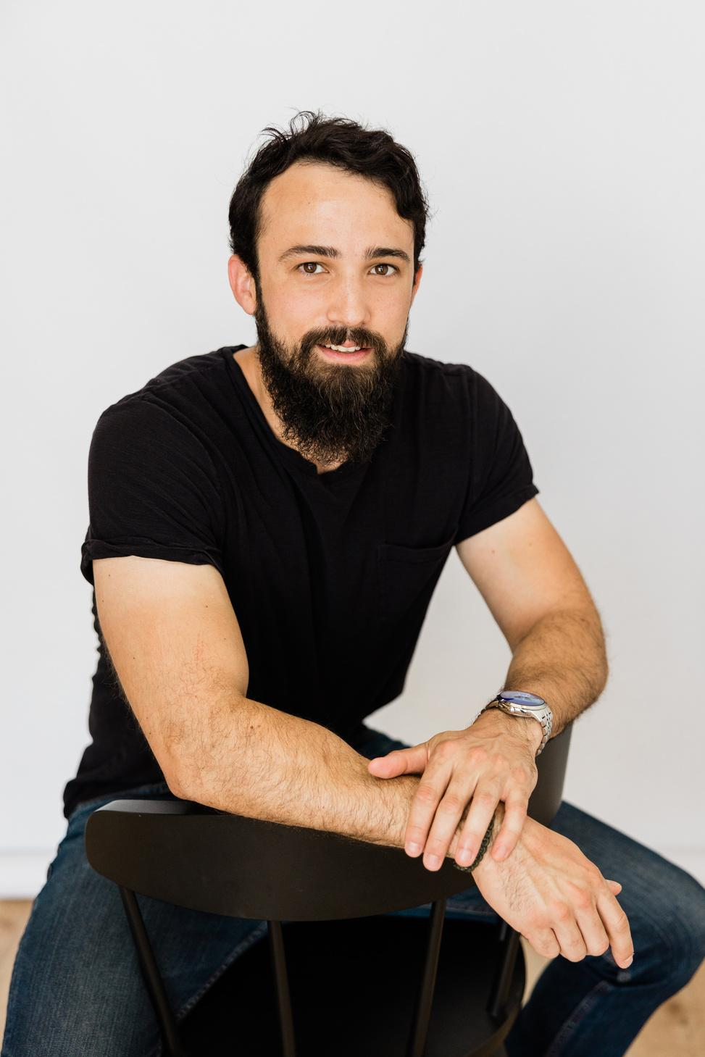

11. Founder (s) and Core Team:
What are your unique competencies and abilities that can’t be copied?
Name
Name
Olivia Wilson
Designation
Designation
Marketing Head
The Visionary
(CEO)
The Hustler
(The person who manages
the operations)
The Hacker
(the programmer or main
product developer)

Slide 13
12. Future Plans & Roadmap
Revenue, Customers, Partnership etc.

Slide 14




THANK YOU
16. Contact Info
Cell phone - Landline
Email id
Website
Address
Notes:
Linkedin Profile(s):
Contact No.
Social Media Handle(s) of the startup/ product:
Website:

